Slide 1
More on K-maps

Slide 2
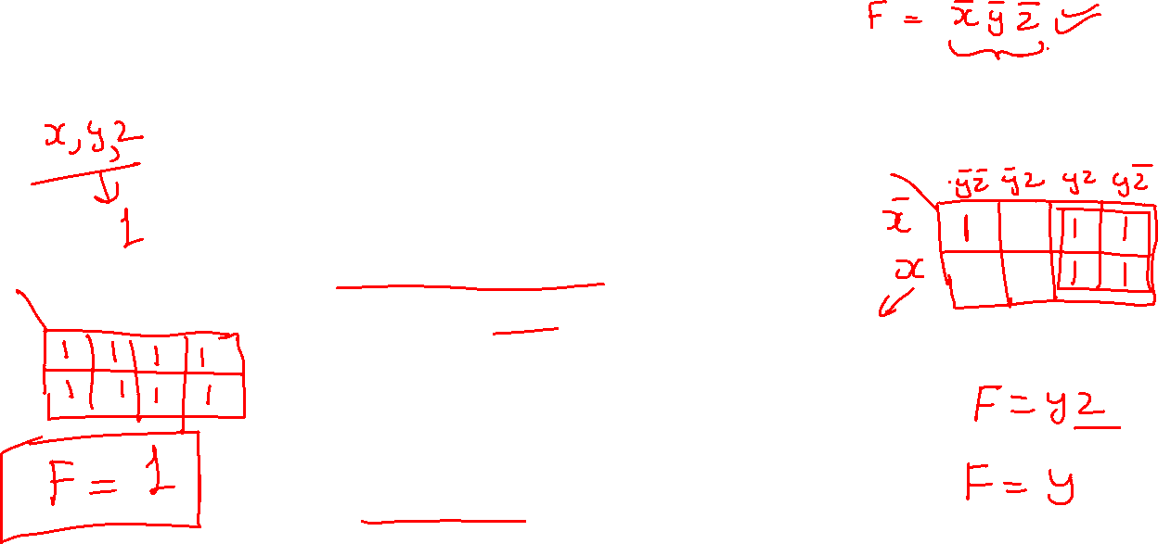
Combining 1’s
By combining squares, we reduce number of literals in a product term, reducing the literal cost, thereby reducing the other two cost criteria
On a 3-variable K-Map:
One square represents a minterm with three variables
Two adjacent squares represent a product term with two variables
Four “adjacent” terms represent a product term with one variable
Eight “adjacent” terms is the function of all ones (no variables) = 1.

Slide 3
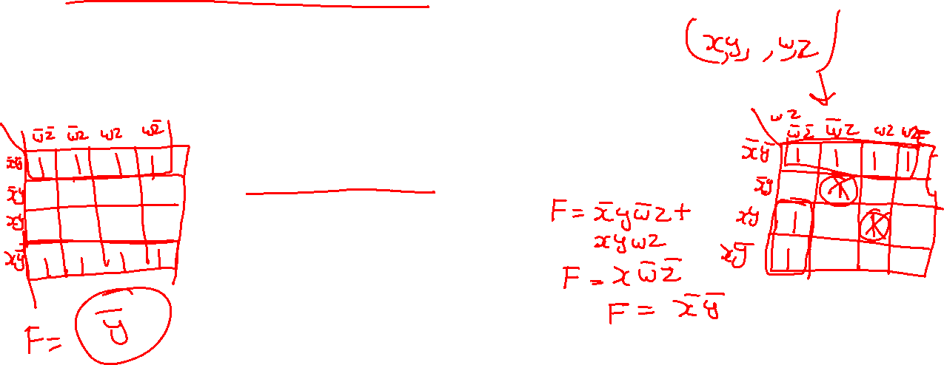
Four Variable Terms
Four variable maps can have rectangles corresponding to:
A single 1 = 4 variables, (i.e. Minterm)
Two 1s = 3 variables,
Four 1s = 2 variables
Eight 1s = 1 variable,
Sixteen 1s = zero variables (i.e. Constant "1")

Slide 4
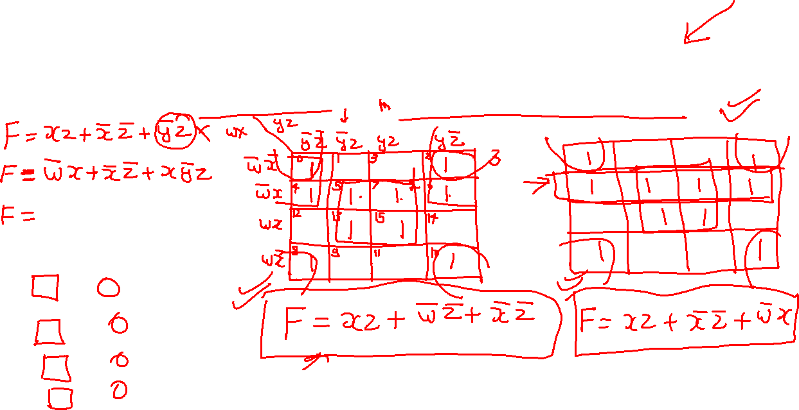
Four-Variable Map Simplification
F(W,
X,
Y,
Z)
=
Σ
(0,
2,4,5,6,7,
8,10,13,15
)

Slide 5
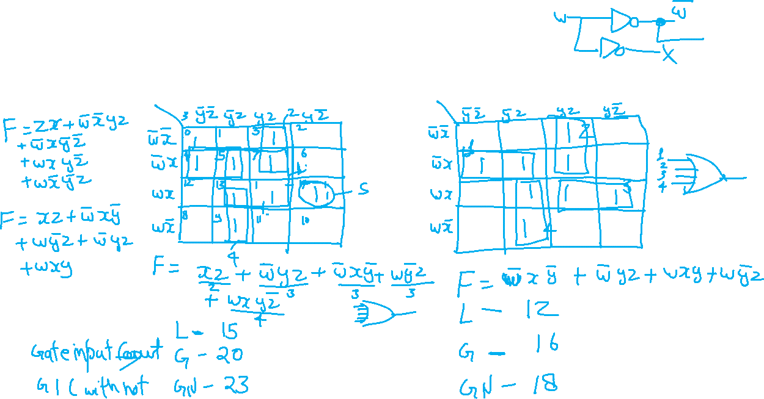
Four-Variable Map Simplification
F(W,
X,
Y,
Z)
=
Σ
(3,4,5,7,9,1
3,14,15
)
m
Notes:
F = W' X Y' + W' Y Z + WXY + WY'Z

Slide 6
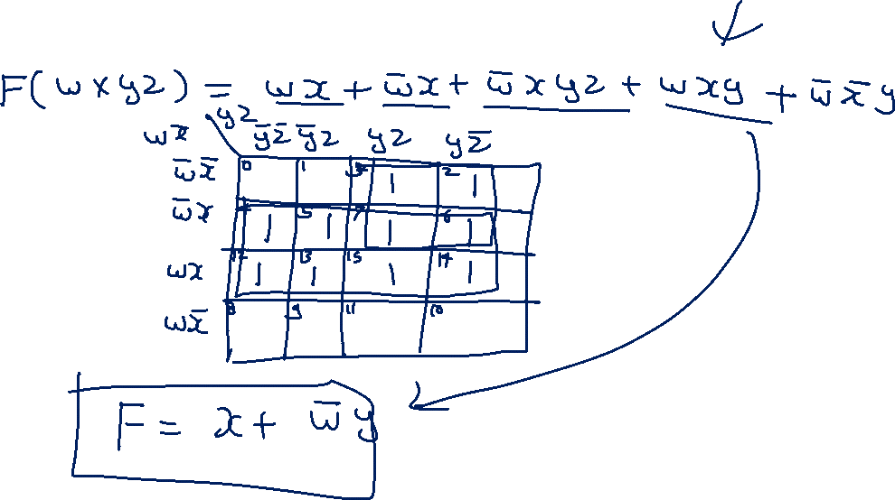
Fill a K-map from Boolean equation

Slide 7
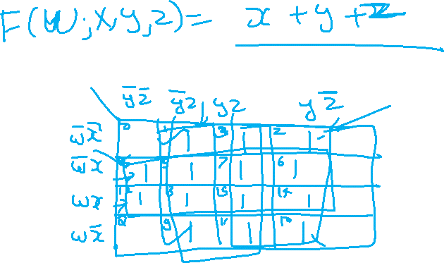

Slide 8
